Slide 1

Learning Android

Slide 2
Introduction
Android is a software stack for mobile devices that includes:
an operating system
middleware
key applications
Google is the leading company to develop and promote android. Other companies involved are T-Mobile, HTC, Qualcomm etc

Slide 3
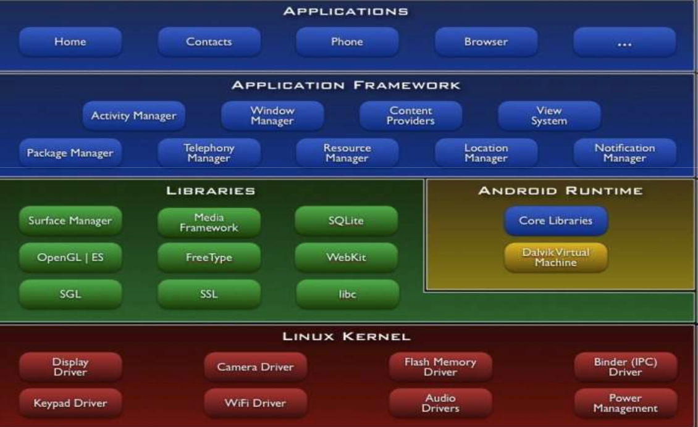
Architecture
Notes:
Content Providers – data access
SGL – 2D graphics engine

Slide 4
Application Fundamentals
Android applications are written in the Java programming language. The
android SDK tools compile the code into an android package, an archive file with an .apk suffix.
All the code in a single .apk file is considered to be one application and is the file that Android-powered devices use to install the application.

Slide 5
Application Components
Activities
A single screen with a user interface.
Services
A component that runs in the background to either perform
long-running operations
remote processes
Content Providers
Manages a shared set of application data
Broadcast Receivers
A component that responds to broadcasted announcements
Notes:
Intents activate the components

Slide 6
Application Resources
An android app is composed of the following:
Code
Resources – update application resources
Animations
Menus
Styles
Colors
Views
Notes:
Intents activate the components

Slide 7
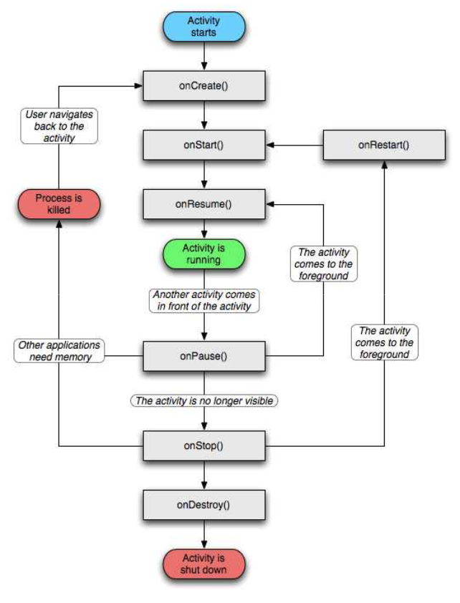
Activity Life Cycle
Notes:
Intents activate the components

Slide 8
The Fun Part

Slide 9
Development Environment
Android Studio
https://developer.android.com/studio/
How To …
https://www.tutorialspoint.com/android/ (Easy for beginners)
https://developer.android.com/training/basics/firstapp/
Notes:
Intents activate the components

Slide 10
Development Environment
Android Studio
https://developer.android.com/studio/
How To …
https://www.tutorialspoint.com/android/ (Easy for beginners)
https://developer.android.com/training/basics/firstapp/
Notes:
Intents activate the components

Slide 11
Assignment
Download Android Studio
Install android studio and ensure the SDK is running.
Play around
Notes:
Intents activate the components

Slide 12
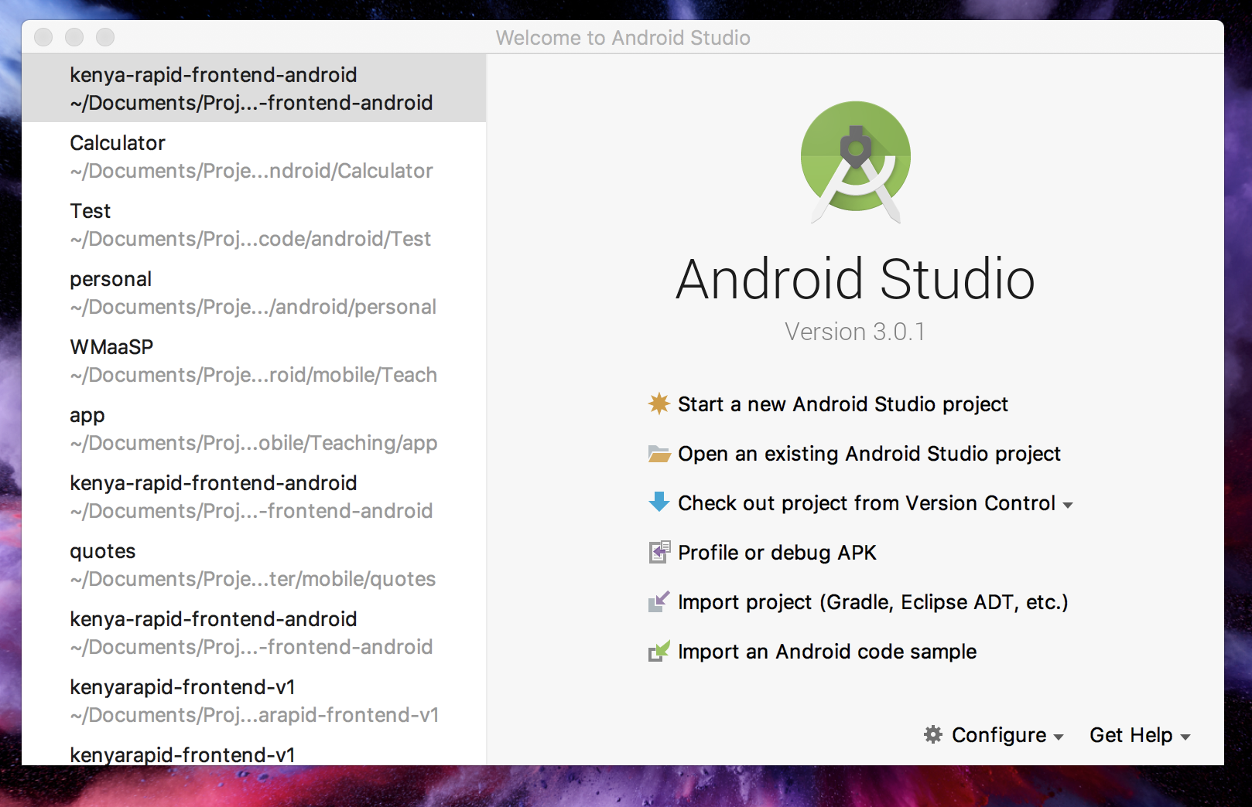
Launch Android Studio
Notes:
Intents activate the components

Slide 13
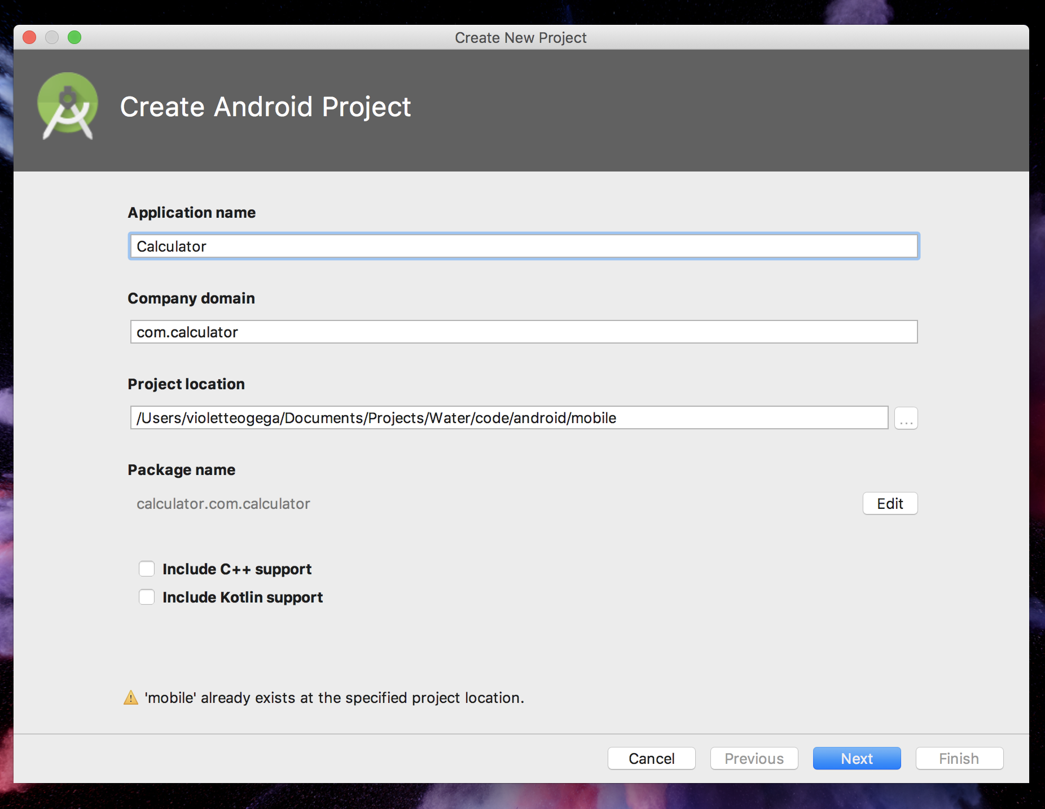
Name, Doman & Location
Notes:
Intents activate the components

Slide 14
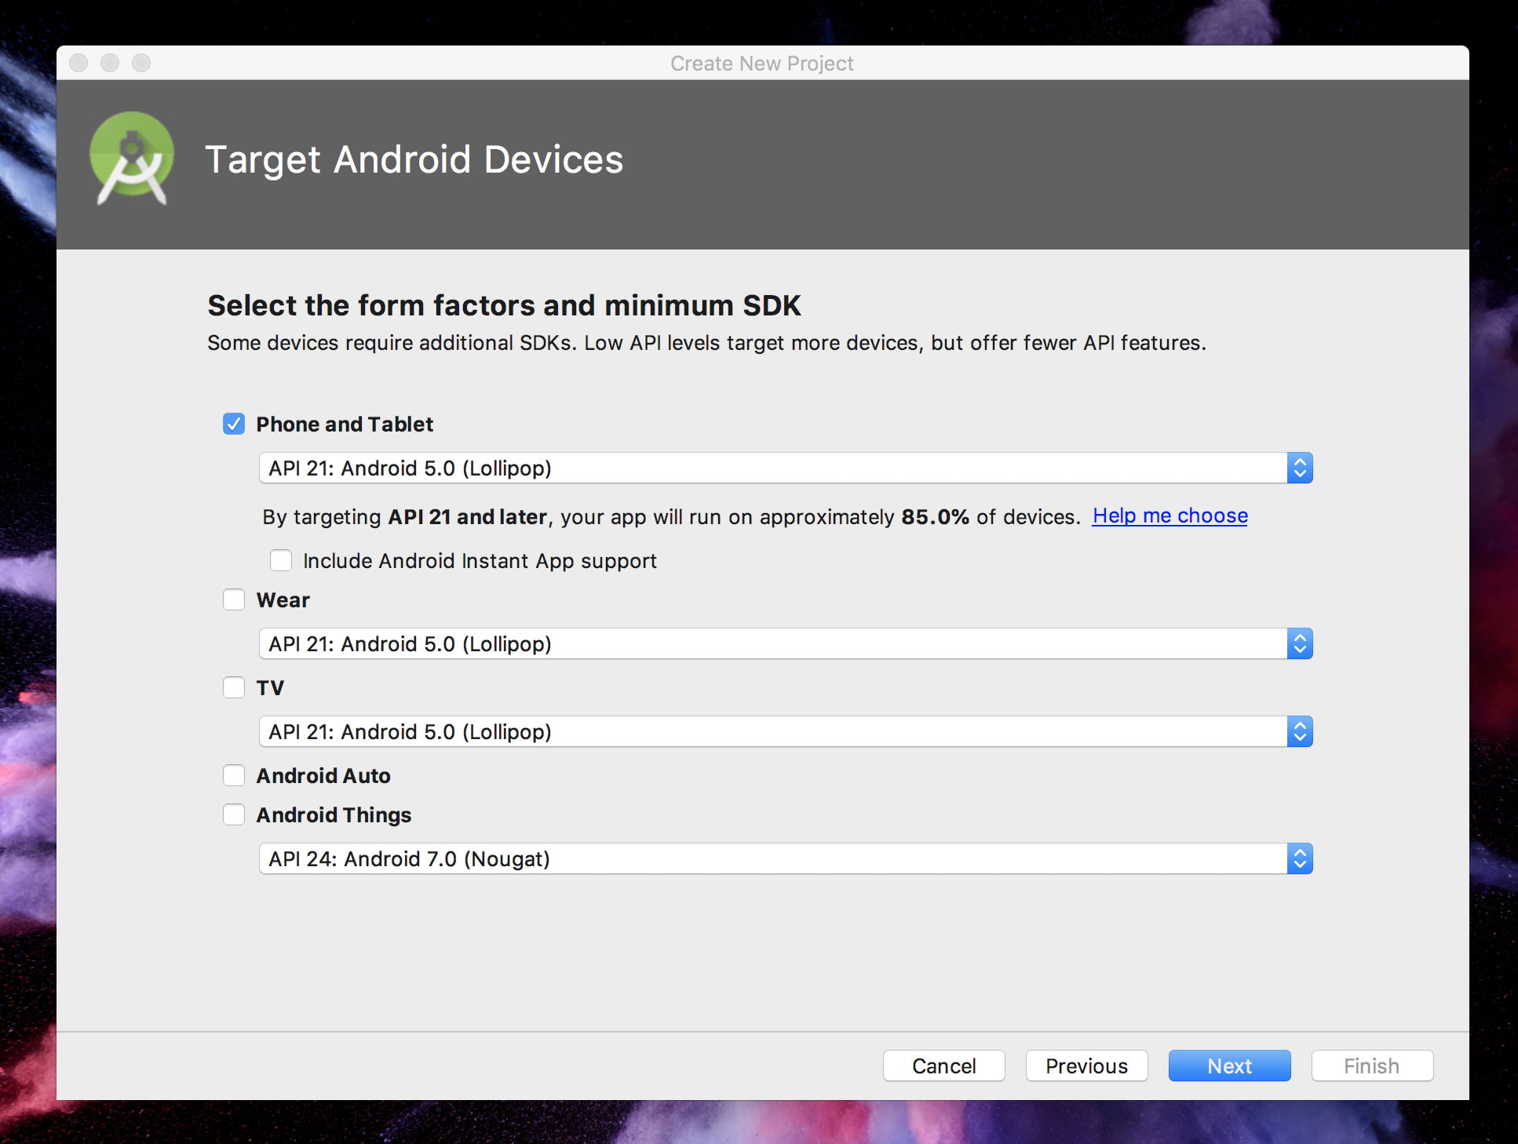
Target Android Device
Notes:
Intents activate the components

Slide 15
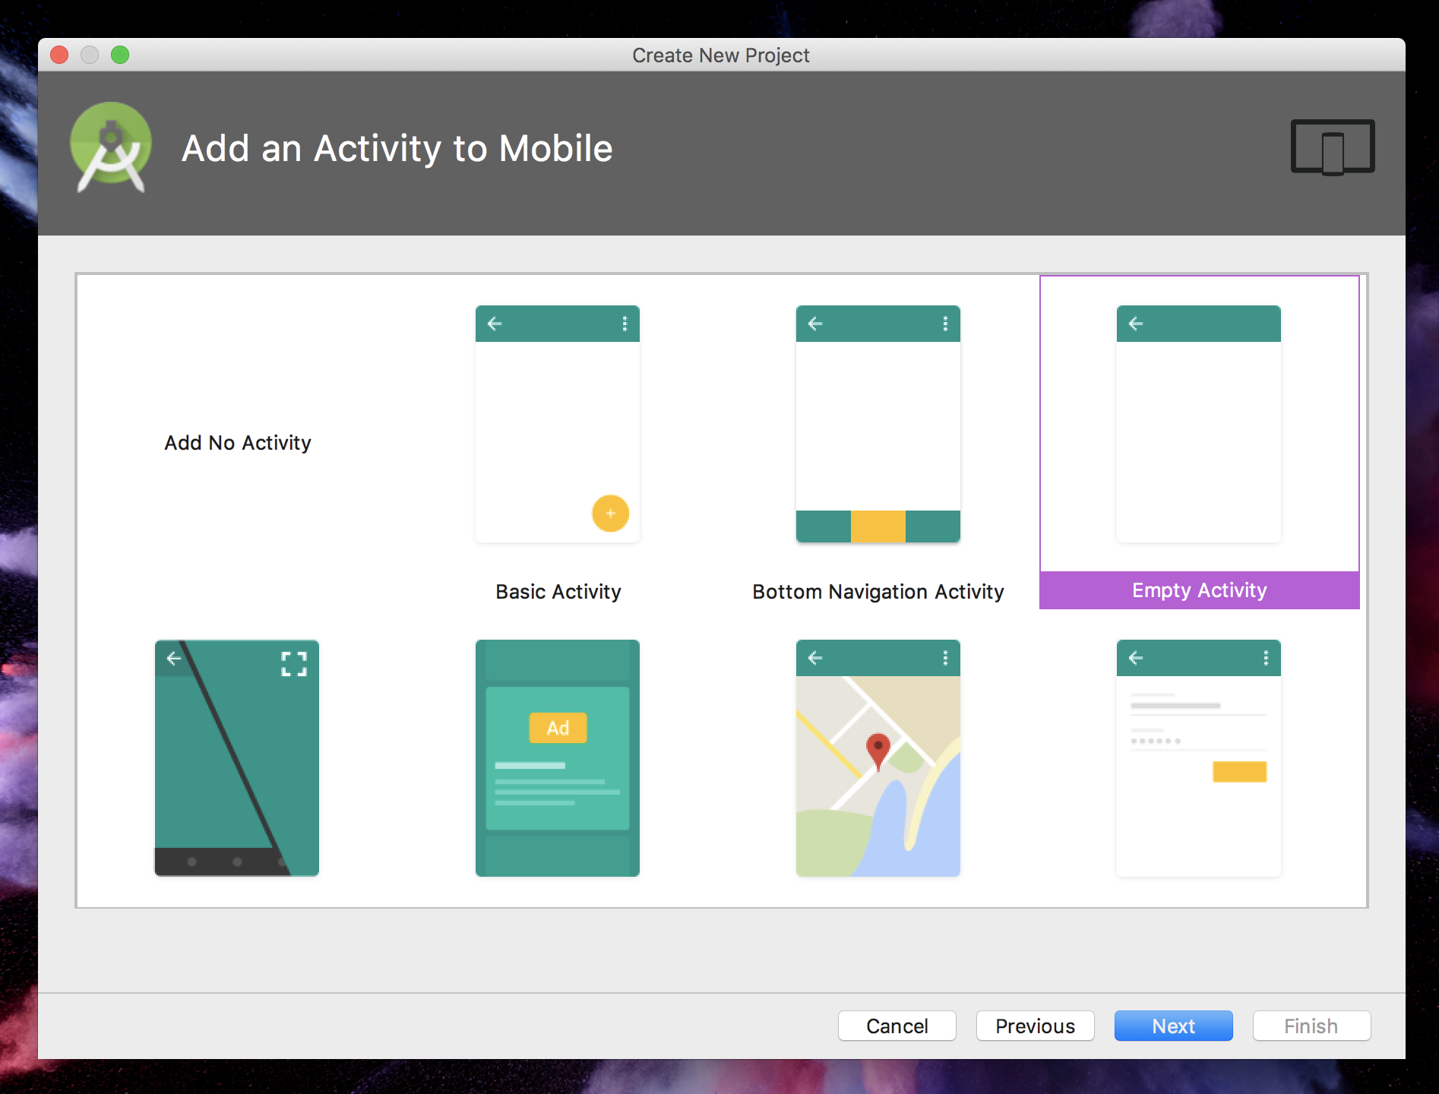
Sample Activity
Notes:
Intents activate the components

Slide 16
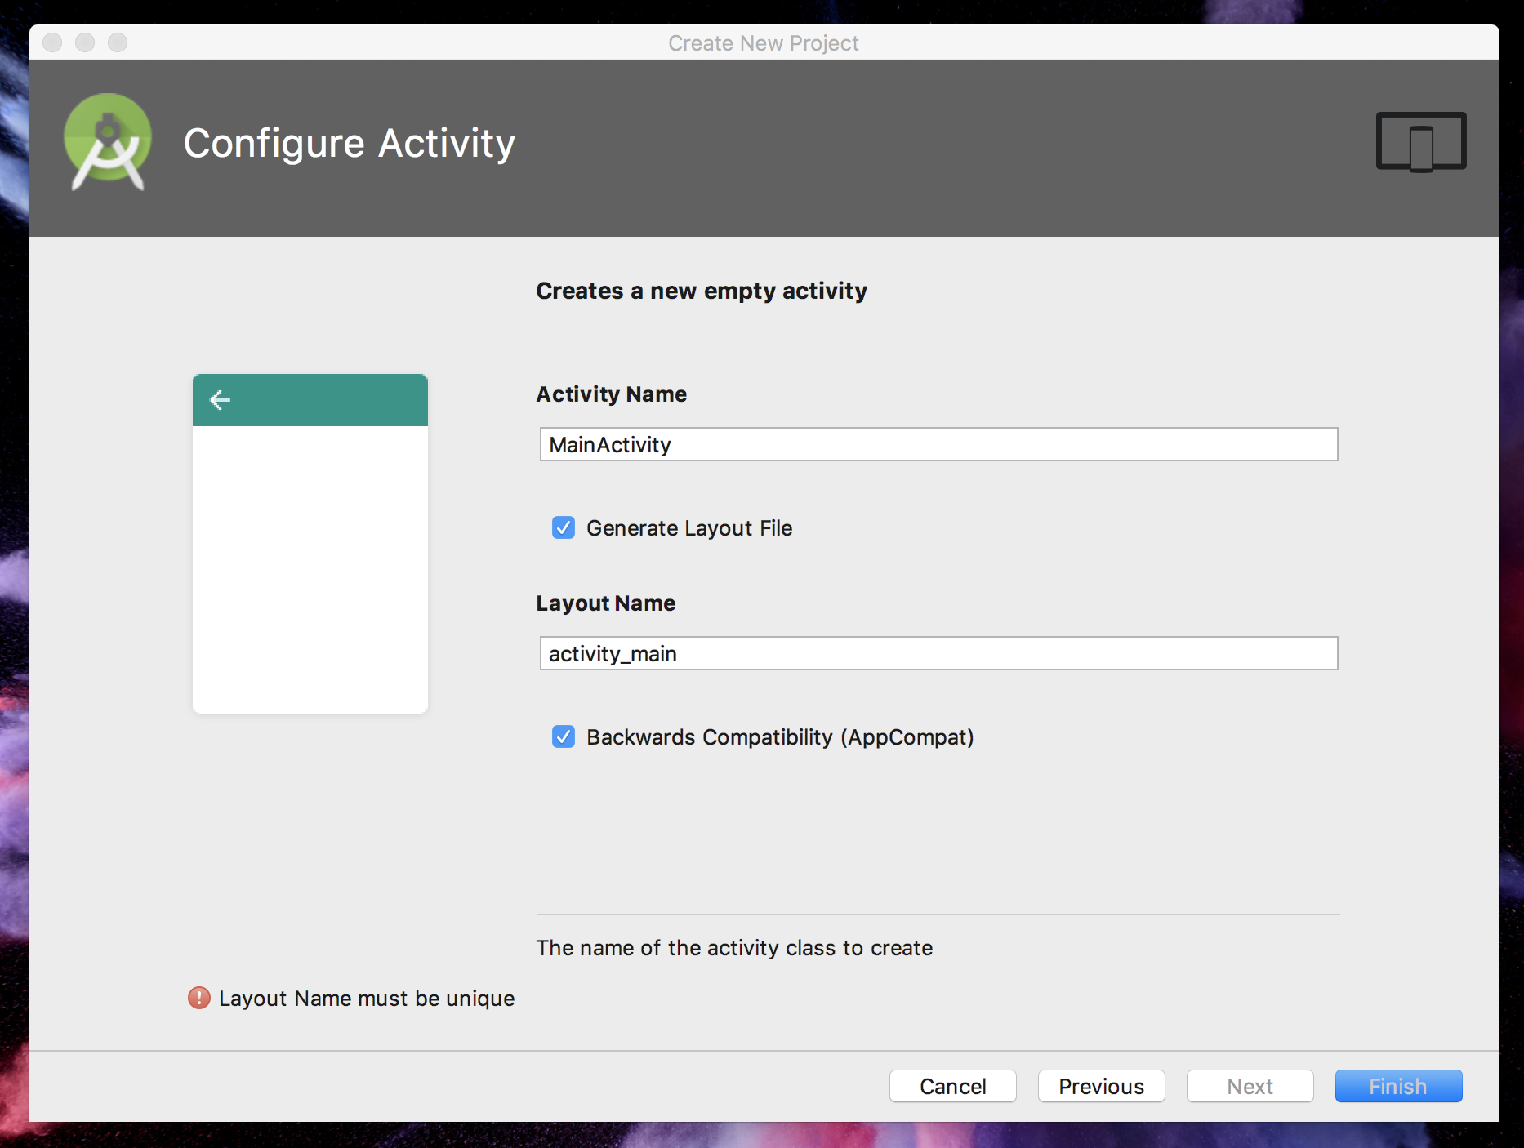
Name your Activity
Notes:
Intents activate the components

Slide 17
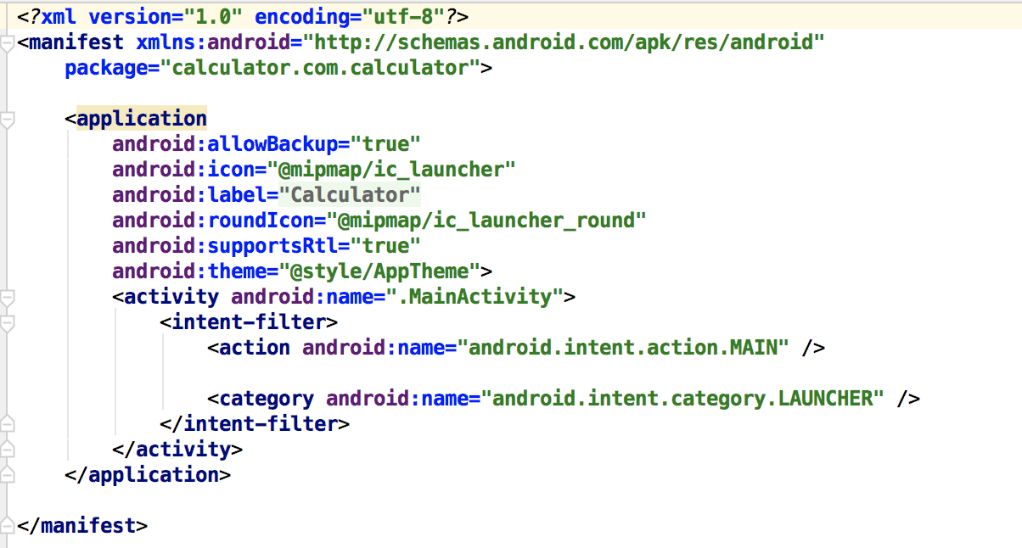
Entry Point: Manifest File
Notes:
Intents activate the components

Slide 18
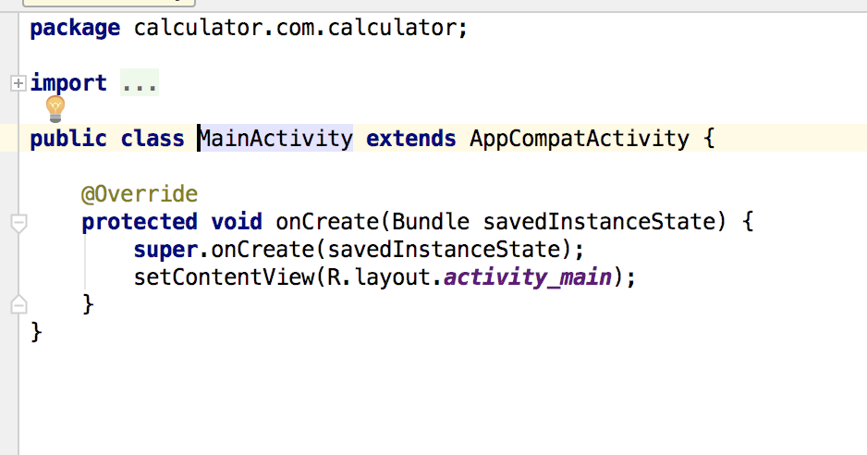
Activity
Notes:
Intents activate the components

Slide 19
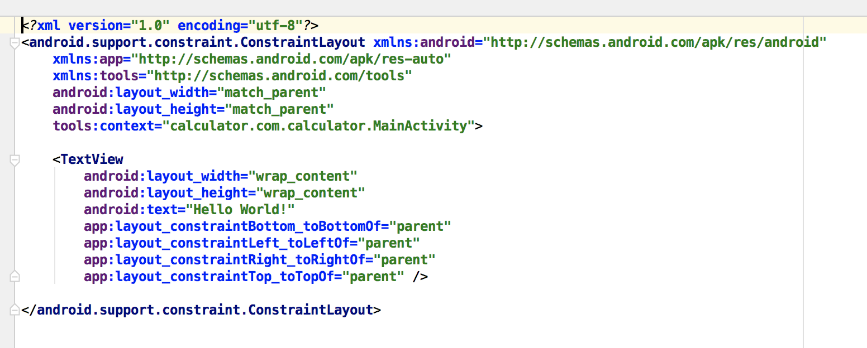
Layout
Notes:
Intents activate the components

Slide 20
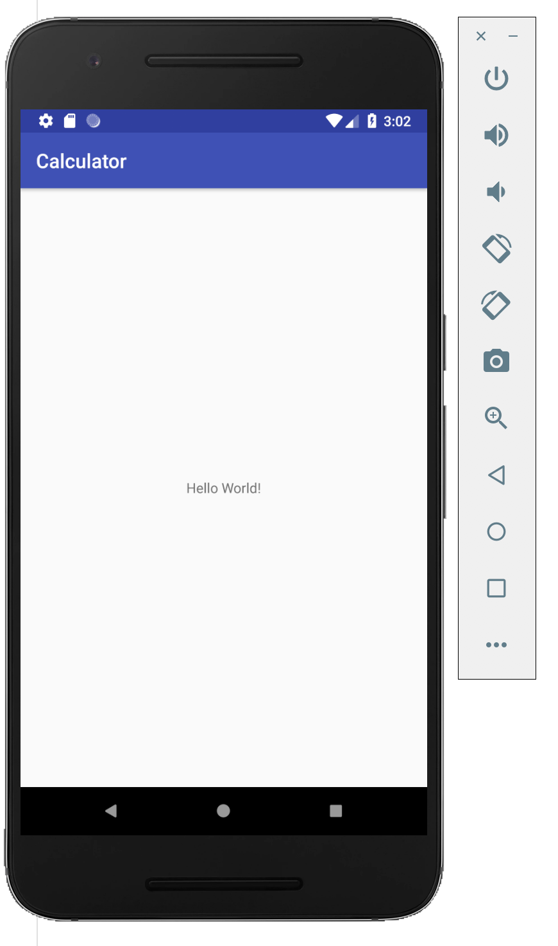
Run the Application
Notes:
Intents activate the components

Slide 21
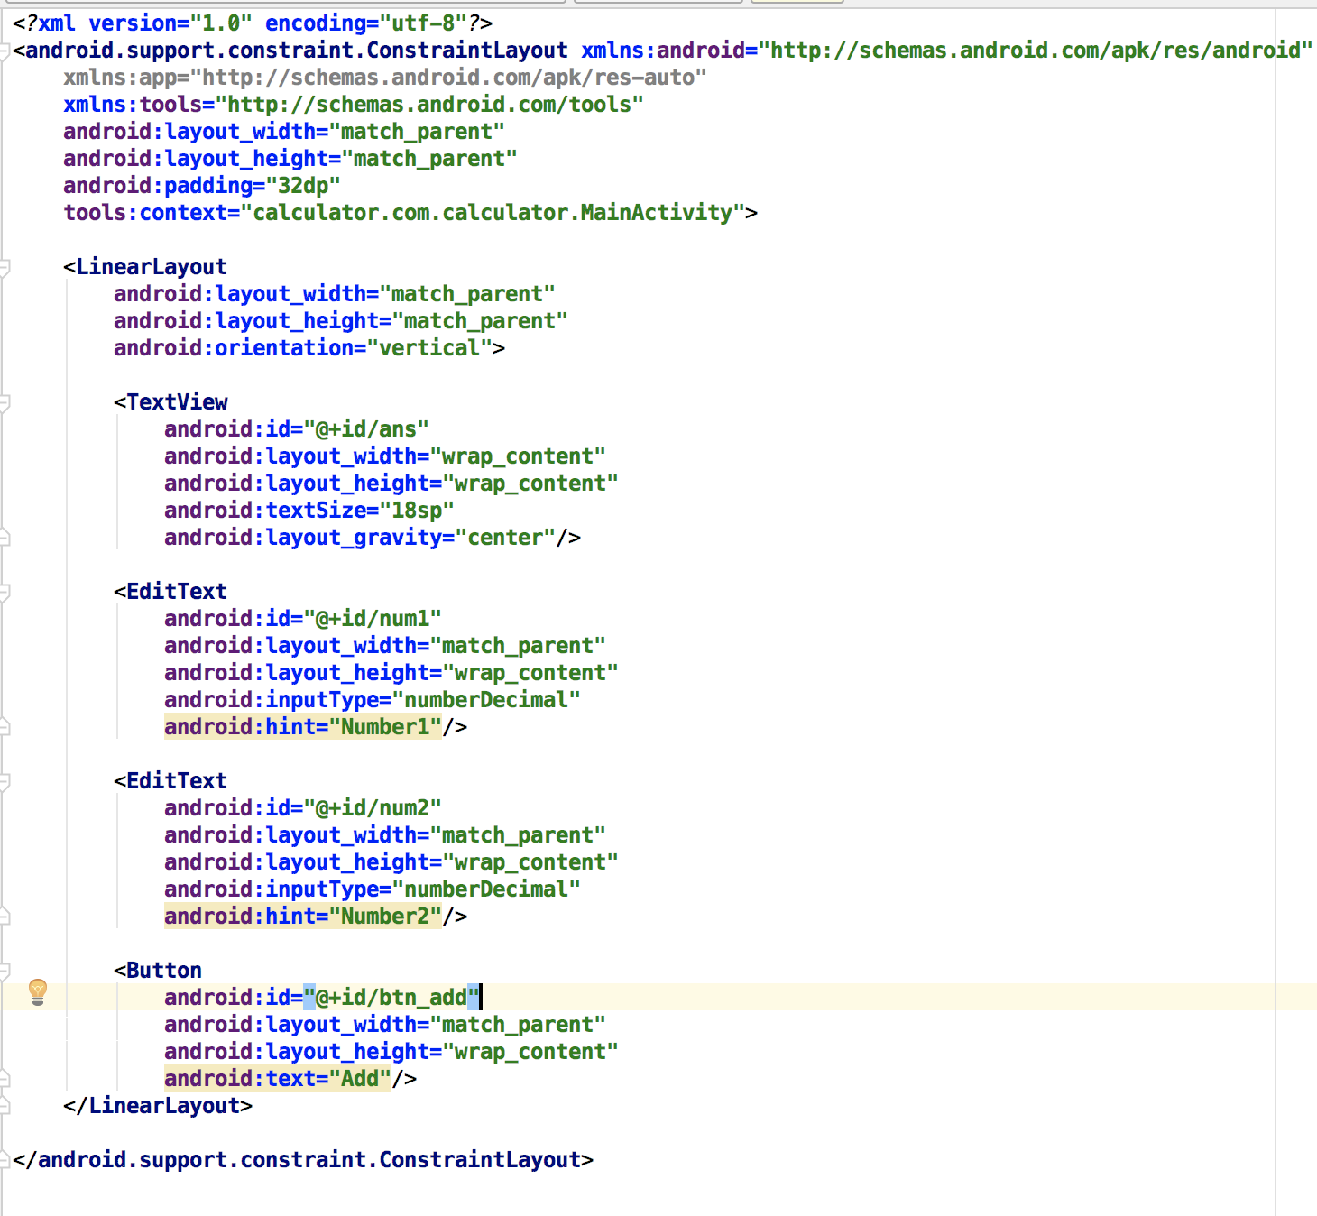
First View
Notes:
Intents activate the components

Slide 22
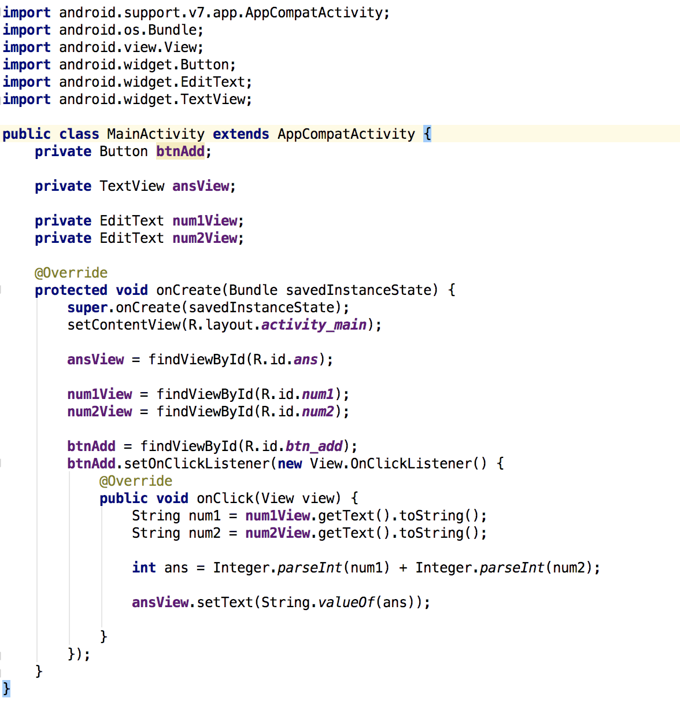
Interacting with the Layout
Notes:
Intents activate the components

Slide 23
HAVE FUN No Friday class Monday class will be 5pm to 7pm

